Slide 1
PROJECT PROPOSAL FOR NATIONWIDE INSURANCE COMPANY WIRELESS NETWORK Version 1.0 12/10/2014
Glen Sayarot, Michael Fetick

Slide 2
Roles & Responsibilities
Glen Sayarot – Network Engineer
Project Management
Systems Architecture / Policies
Wireless Network Design
Routing / IP Addresses
Mike Fetick – Network Engineer
Wireless Network Design
Product Research & Procurement
Security Protocols
Systems Setup & Testing

Slide 3

About the Client
The client’s expanded workforce needs access to company data via a wireless network
“I can’t hardly wait
for the WLAN to
get our support
staff online.”

Slide 4


Problems before a wireless network
Wasted Time
Wasted Paper

Slide 5

Ultimately, the Big Problem
Client Dissatisfaction

Slide 6
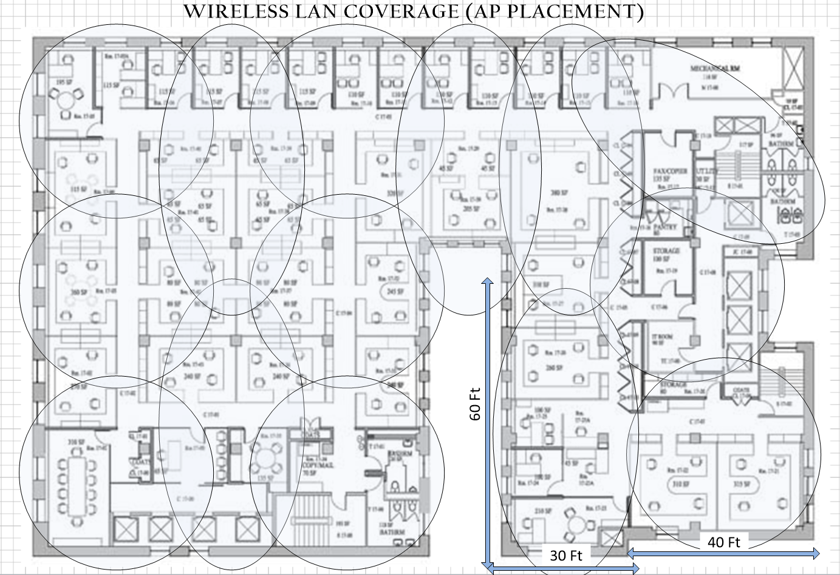
The Wireless Solution!
Add a wireless network to expand the company LAN !

Slide 7
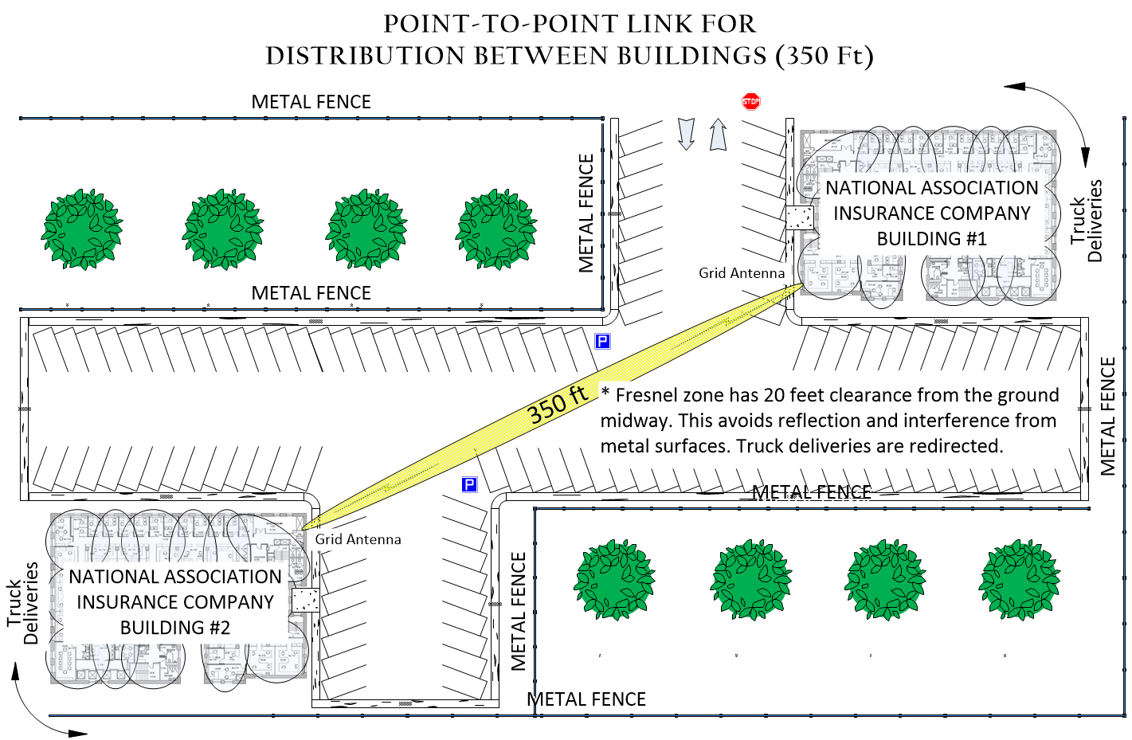
Network Multiple Buildings!

Slide 8

Rationale for Design Choices
Business Case Analysis
Site Survey Access Point Form
Site Survey Questionnaire
Existing Wired Local Area Network
Product Capabilities

Slide 9
Network Design
IP Addressing

Slide 10
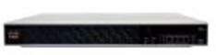
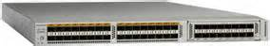
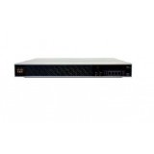
System Components
Hardware Network Controllers
(2) Cisco 5508 Wireless Controller (AIR-CT5508-50-K9)
(List: $15,680) Amazon: $6,500 x 2 = $13,000
Hardware Routers and Switches
Cisco Nexus 5548 Layer 3 Switching Module (N55-D160L3)
(List: $6,500) router-switch.com: $3,200 x 1 = $3,200
With Software: NX-OS 5.2(1)N1(3) Layer 3 License
Hardware Security Equipment (Firewall)
(1) Cisco ASA 5512-X IPS Edition - Security Appliance
(ASA5512-IPS-K9) (List: $3,200) Amazon: $1,730 x 1 = $1,730
An addition to the wired LAN’s existing SonicWall Firewall

Slide 11
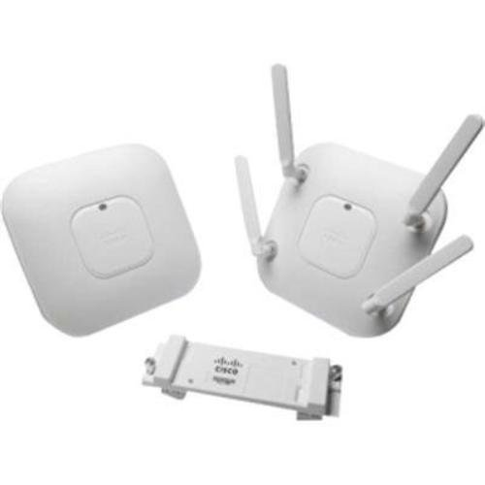
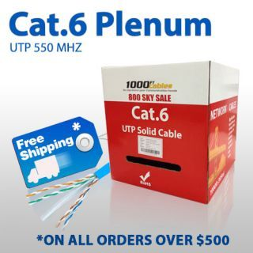
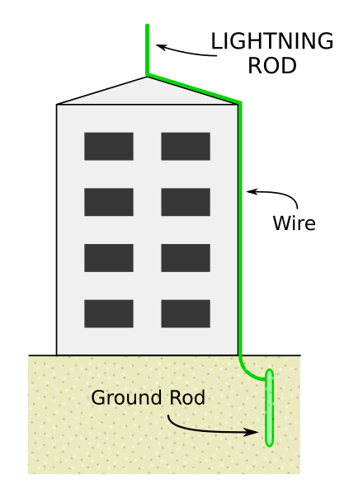
System Components
Hardware Wireless Access Points
(50) Cisco Aironet 3700 Series AP
(List: $1,495) Amazon: $720 x 30 = $36,000
Hardware Cabling and Connectors
(2) 1000 ft. Cat.6 Plenum (CCA) Ethernet Cable,
UTP 550 MHz,
(List: $72) Amazon: $225 x 2 = $450
Hardware Lightening Protection Equipment
(2) Lightening Rod Installation - www.fixr.com
Local electrician typically $2,500 x 2 buildings = $5,000

Slide 12
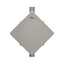
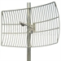
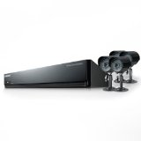
System Components
Hardware Outdoor Antennas
(2) Cisco Bridge AIR-XLTC50DA31AK9 ExtendAir r5005, 5 GHz Outdoor Bridge w/Ant, A Reg Domain
(List: $5,200) router-switch.com: $5,200 x 2 = $11,400
Hardware Outdoor Antennas
(2) 1000 ft. Cat.6 Plenum (CCA) Ethernet Cable,
UTP 550 MHz,
(List: $72) Amazon: $225 x 2 = $450
Hardware Outdoor Cameras
(2) Samsung SDE-3004N 4 Channel DVR Security System with 500 GB HDD. One for each building.
(List: $400) Amazon: $250 x 2 = $500

Slide 13
System Cost Summary
Cost-Budget (Hardware Cost Break-Down)
(2) Cisco 5508 Wireless Controller (AIR-CT5508-50-K9) $13,000
(1) Cisco Nexus 5548 Layer 3 Switching Module (Part No. N55-D160L3) $3,200
(1) Cisco ASA 5512-X IPS Edition - security appliance (ASA5512-IPS-K9) $1,730
(50) Cisco Aironet 3700 Series AP $36,000
(2) 1000 ft. Cat.6 Plenum (CCA) Ethernet Cable, UTP 550 MHz $450
(2) Lightening Rod Installation - www.fixr.com $5,000
(2) Cisco Bridge ExtendAir r5005, 5 GHz Outdoor Bridge w/Ant $11,400
(2) Highly Directional Antennas (Wireless Bridge) Grid Antenna $140
(2) Samsung SDE-3004N 4 Channel DVR Security System with 500 GB HDD $500
Miscellaneous items and supplies $2,000
System Design, Installation, Setup, and Certification $20,000
Total: $93,420

Slide 14

IT Dept – Policies Implementation
Network Operations Policy
Wireless Communication Policy
Software Usage Policy
Network Security Policy
Disaster Recovery (DR) Plan

Slide 15

The Major Benefit

Slide 16

Any Questions?

